Slide 1


INTRODUCTION DATA ANALYSIS
Traffic accident analysis in New York City, January-August 2020
Team Infomation
Team 29
Ji Shutong and Wu Henian
2022-11

Slide 2

Content
01
Dataset Descriptions
EDA Questions
Data Analysis by Plots
Interactive Widgets
02
03
04

Slide 3

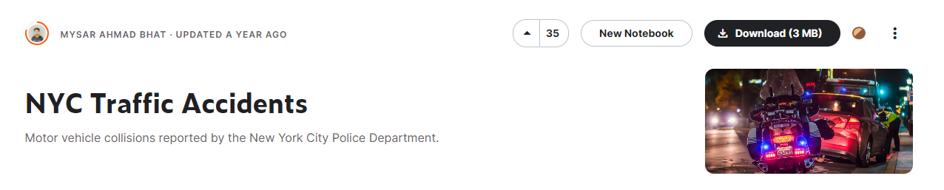
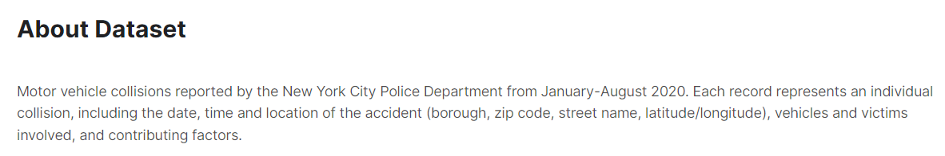
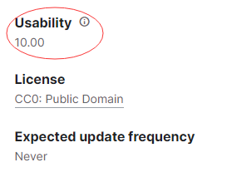
Dataset From Kaggle
https://www.kaggle.com/datasets/mysarahmadbhat/nyc-traffic-accidents
We used kaggle's data set of New York City Traffic Accidents from January to August 2020, it has detailed data description and high Kaggle usability score.

Slide 4
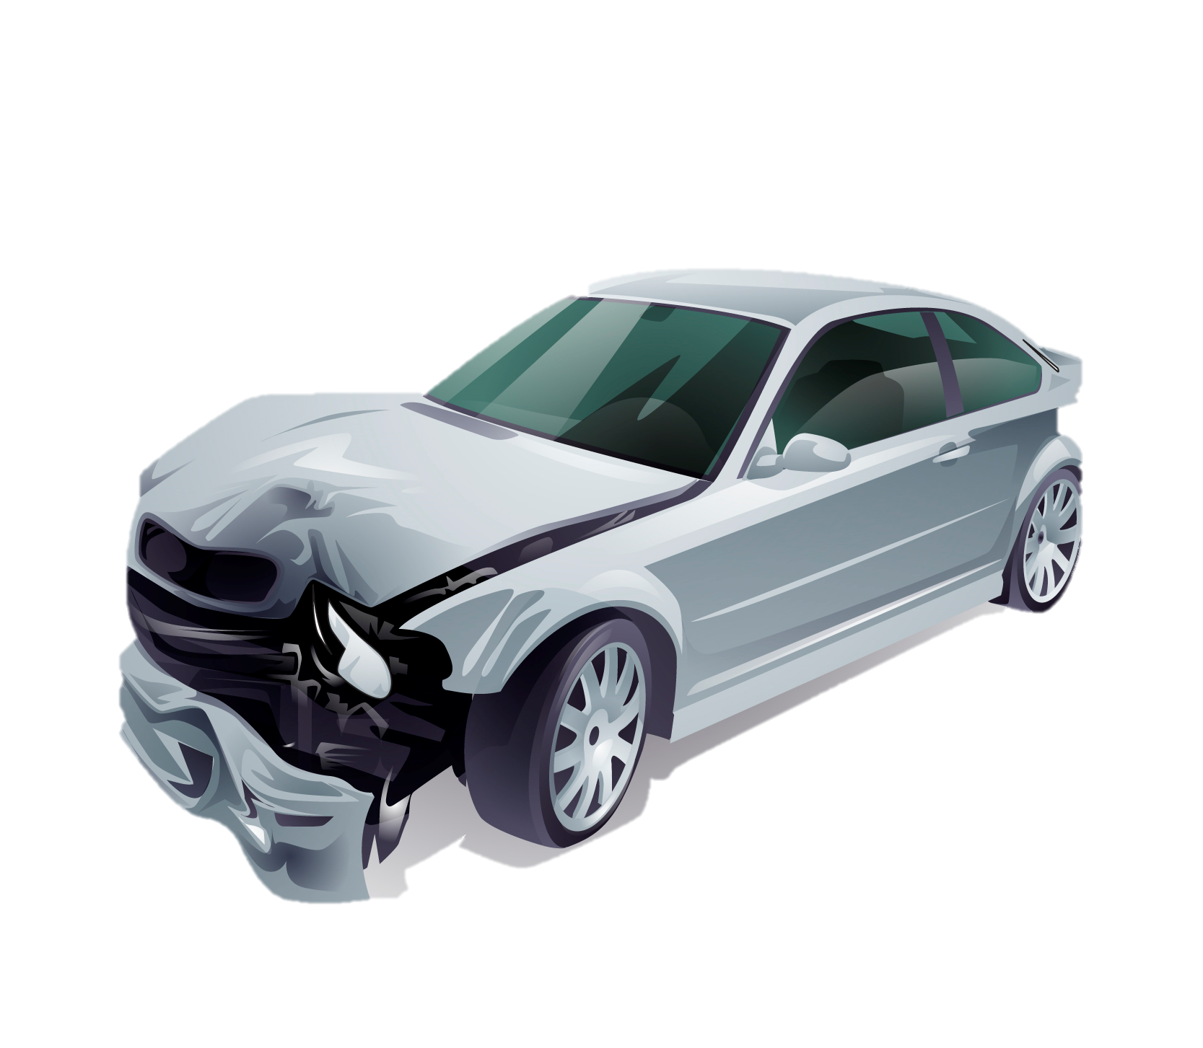
EDA Questions
Car Accidents
During which time frame do most accidents occur? When is the highest proportion?
On which particular borough were the most accidents reported?
What causes the greatest number of traffic accidents?

Slide 5
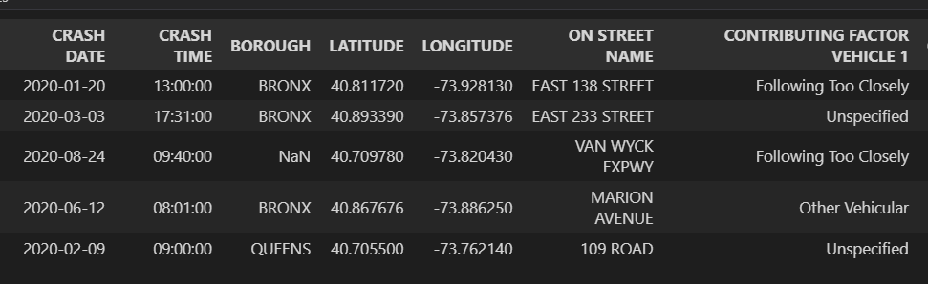
Data Description
NYC Traffic Accidents Dataset- A citywide car accident dataset
mainly Including:
Crash date and time
Accident latitude and longitude
Crash Borough
Contributing Factor

Slide 6
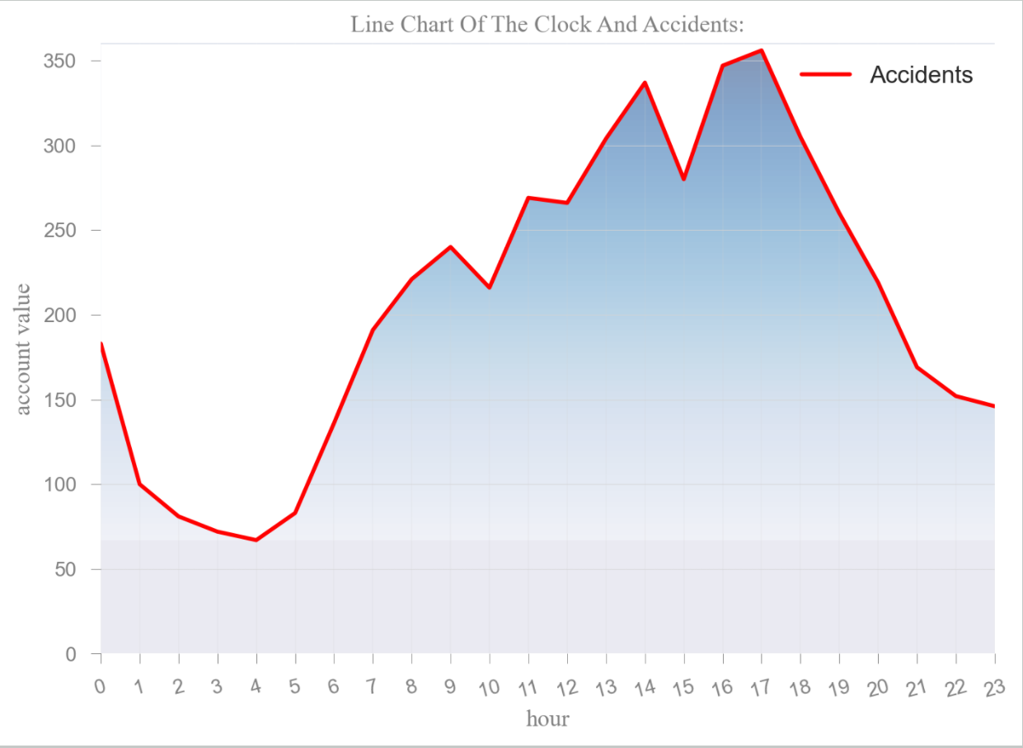
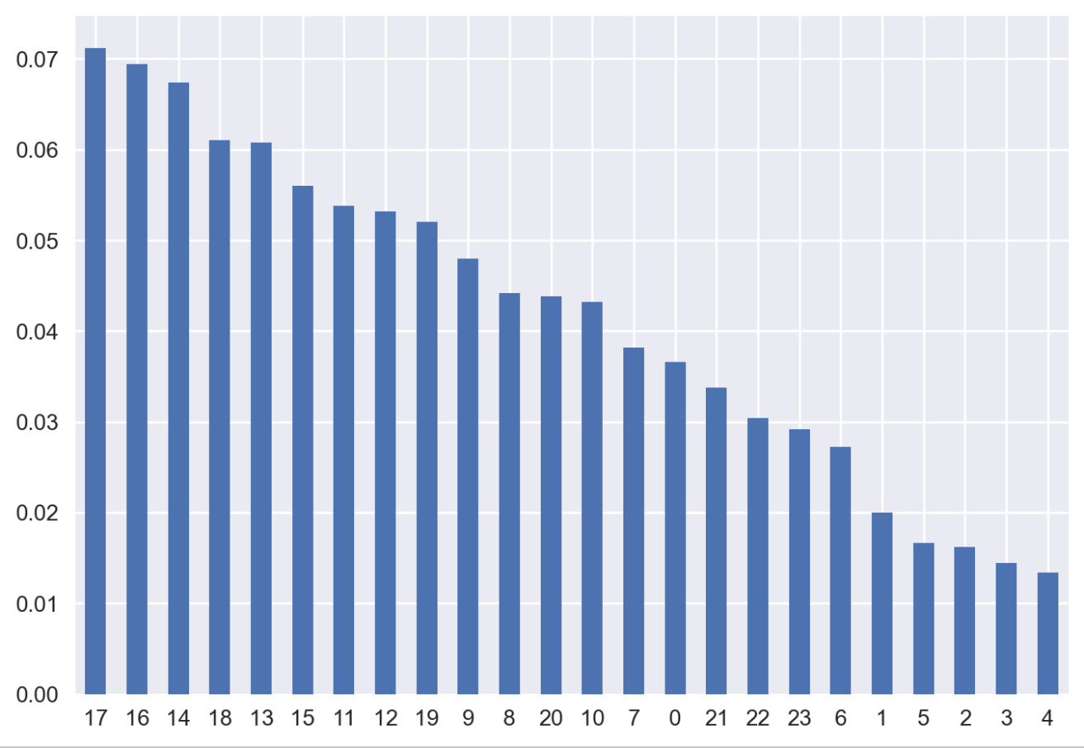
EDA Question 1
During which time frame do most accidents occur? When is the highest proportion?
We drew a line diagram of the number of car accidents per hour. Using pandas for analysis, it can be found that the number of car accidents is most likely to occur at 5 PM, accounting for 7.12%.

Slide 7
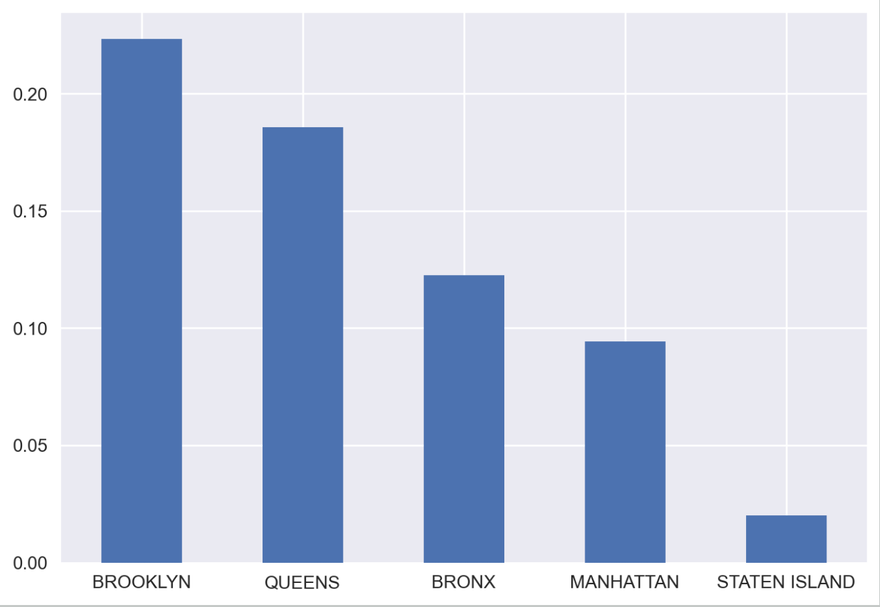
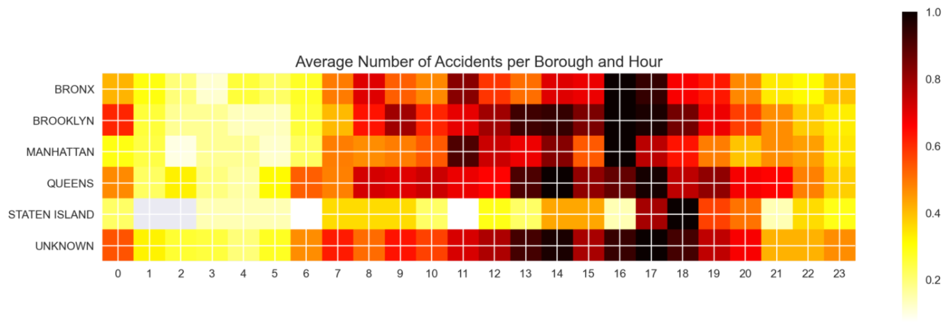
EDA Question 2
On which particular borough were the most accidents reported?
The bar chart shows that, excluding accidents of unknown location, Brooklyn has the largest proportion of accidents, while Staten Island has the least. We also created heat maps to look at the time and the area of the accidents.

Slide 8
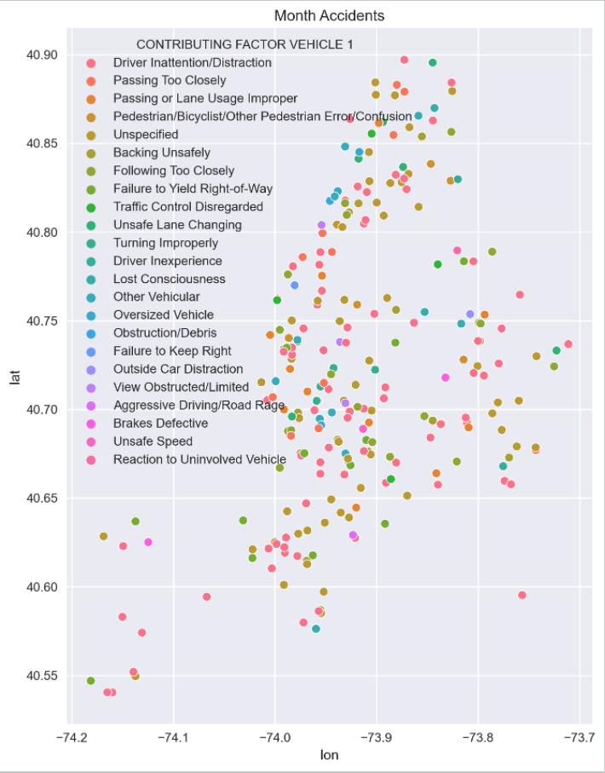
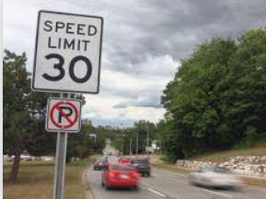


EDA Question 3
What causes the greatest number of traffic accidents?
By taking longitude and latitude as the coordinate axis, we first made the general distribution of accident locations. Different colored dots represent different causes of accidents. It can be roughly seen from the scatter plot that most accidents are caused by distraction while driving. Let's verify it with a bar chart.

Slide 9
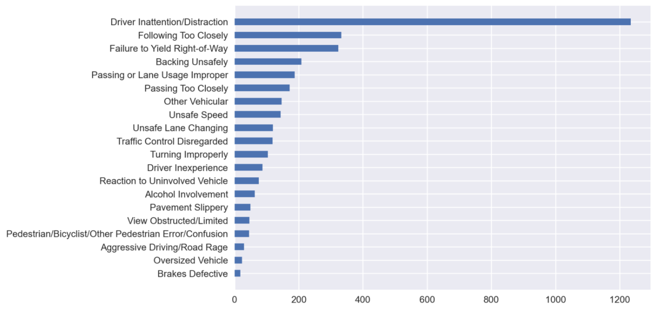
EDA Question 3
What causes the greatest number of traffic accidents?
As can be clearly seen from the bar chart, the main cause of accidents is distraction while driving.

Slide 10
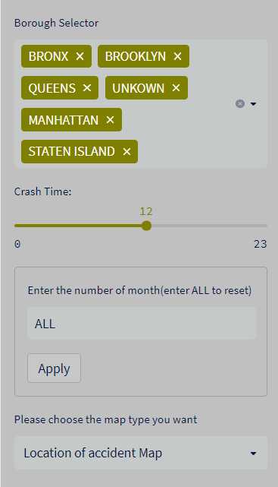
Data App Demo
Interactive Widgets
Four types of filtering widgets:
Multiselect
Slider
Text Input
Selectbox

Slide 11
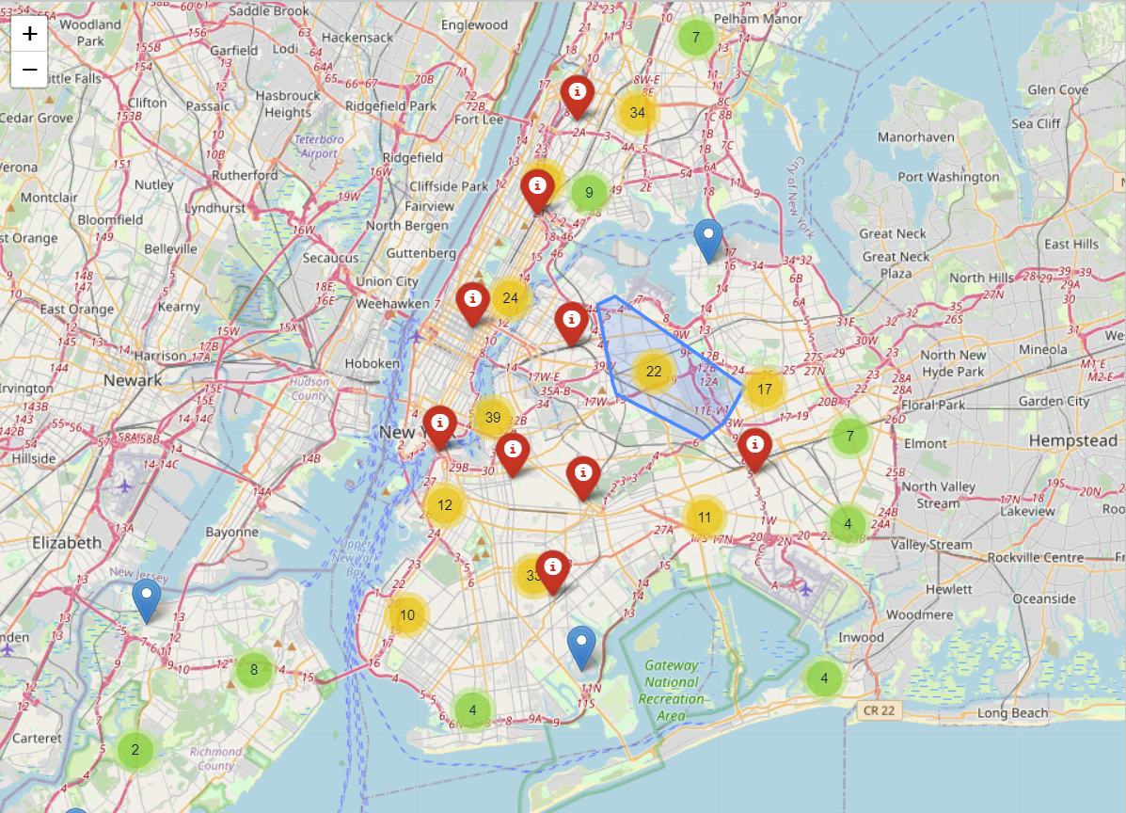
Data App Demo: Map
This map shows that
locations of 5,000 samples where accidents occurred at different times.
- The red markers show the top ten clusters with the largest number after K-Means clustering

Slide 12
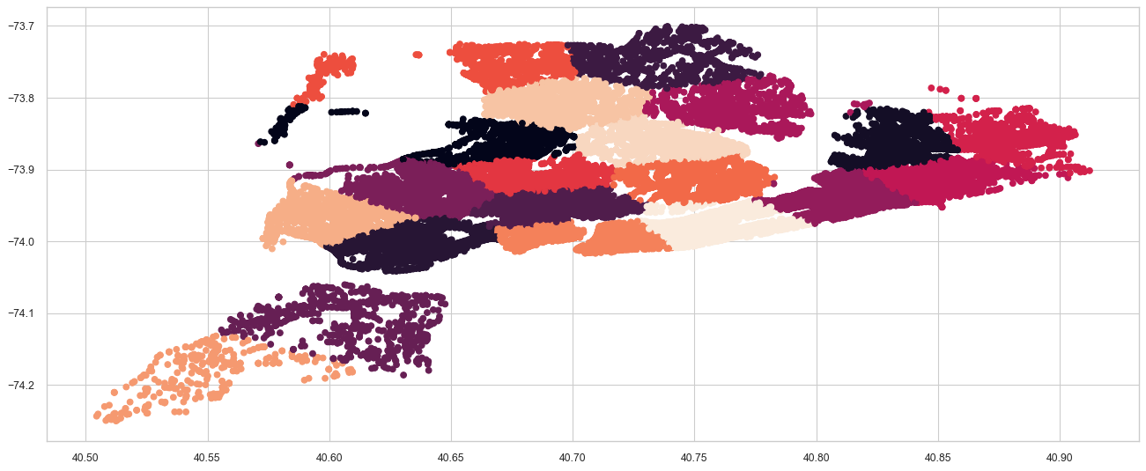
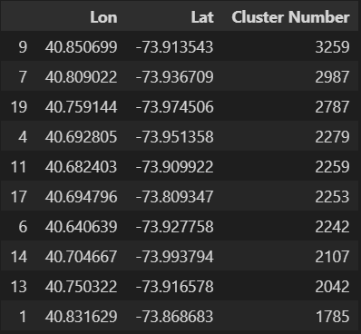
Data App Demo: Map

Slide 13
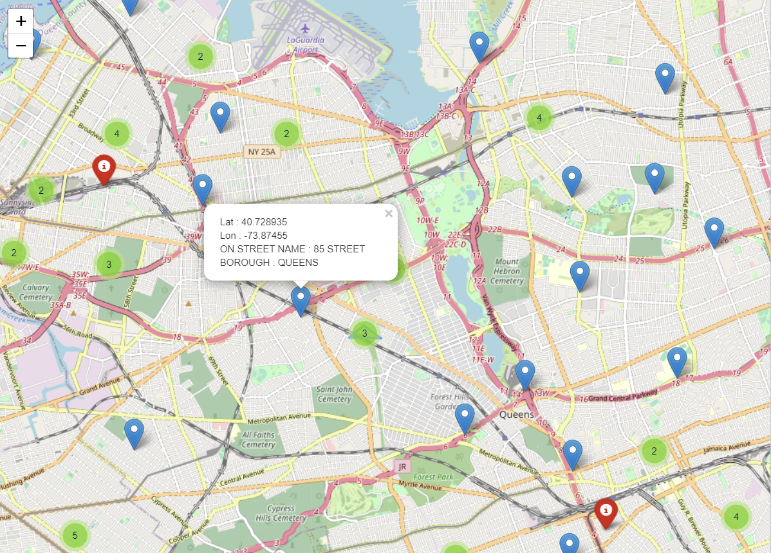
Data App Demo: Map
When you zoom in the map, you can click the blue marker to get the accident information.
You can also click the red marker to get the cluster information.

Slide 14
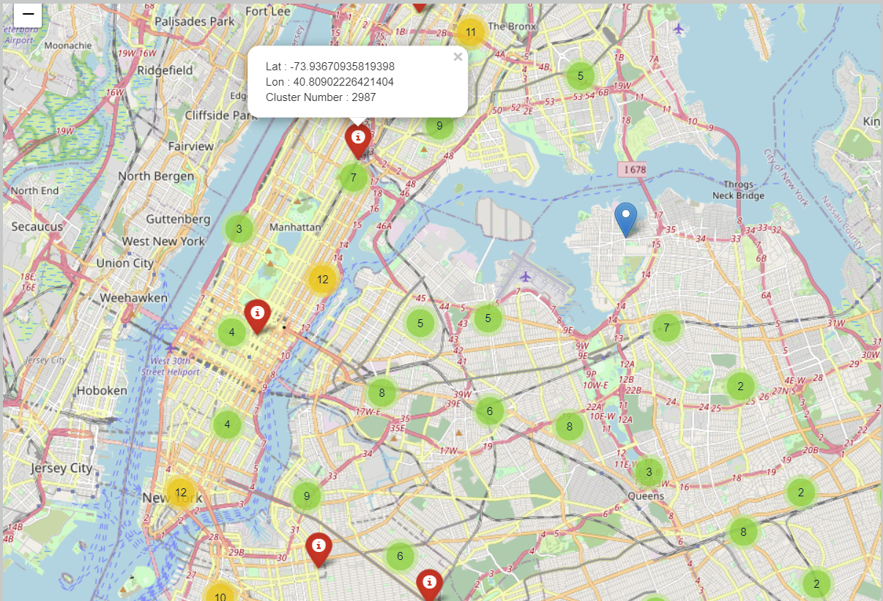
Data App Demo: Map
When you zoom in the map, you can click the blue marker to get the accident information.
You can also click the red marker to get the cluster information.

Slide 15
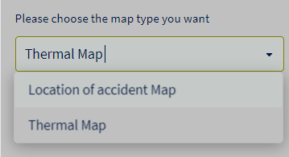
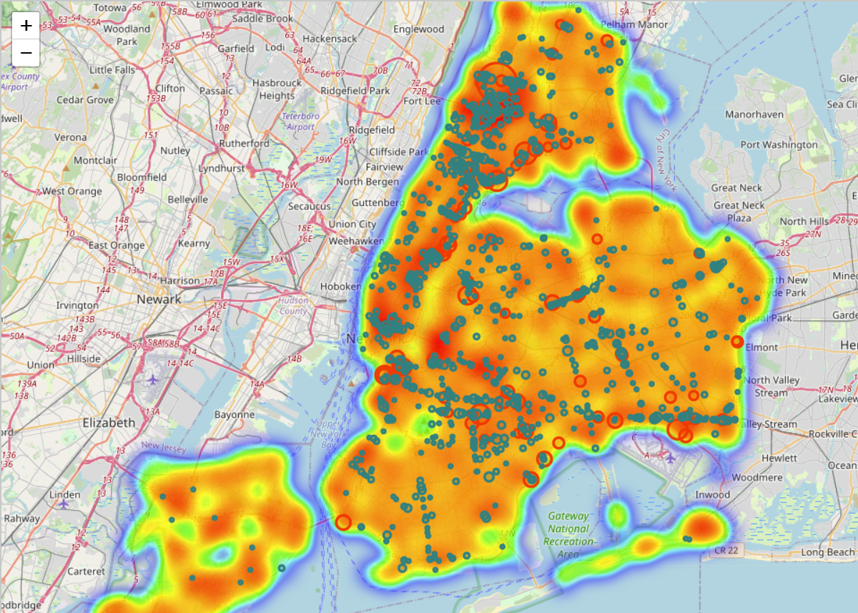
Data App Demo: Thermal Map
Value-Count the location of the accident for all samples.
Radius is used as a marker for the location of accidents. The more accidents occur in the same location, the larger radius marker will be.
Overlay a thermal map on it.

Slide 16
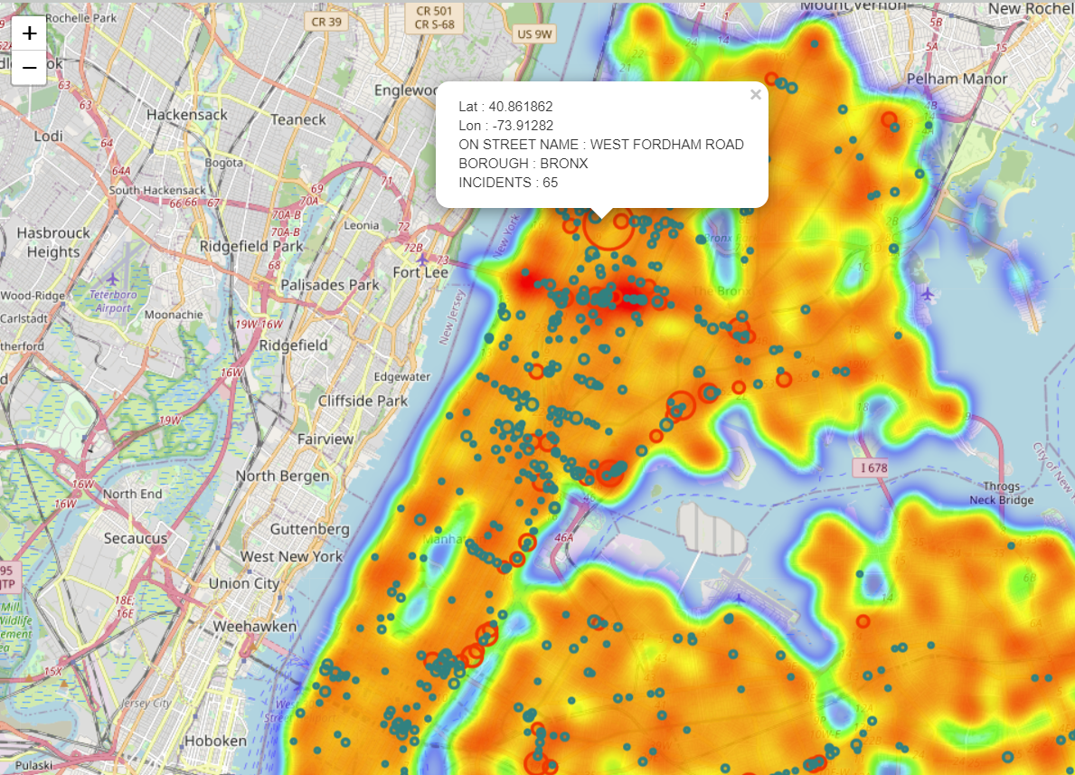
Data App Demo: Thermal Map
If the number of accidents in the same place is greater than 15, the radius marker will be marked as red, and the points less than 15 will be marked as green.
We chose the top 1000 data with the most accidents in the same location for the map.

Slide 17
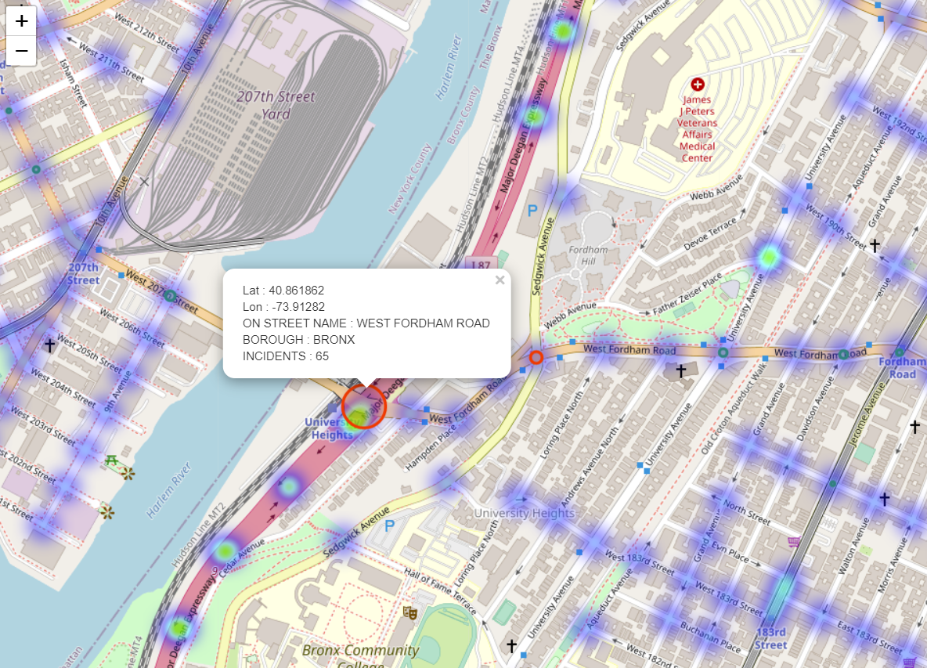
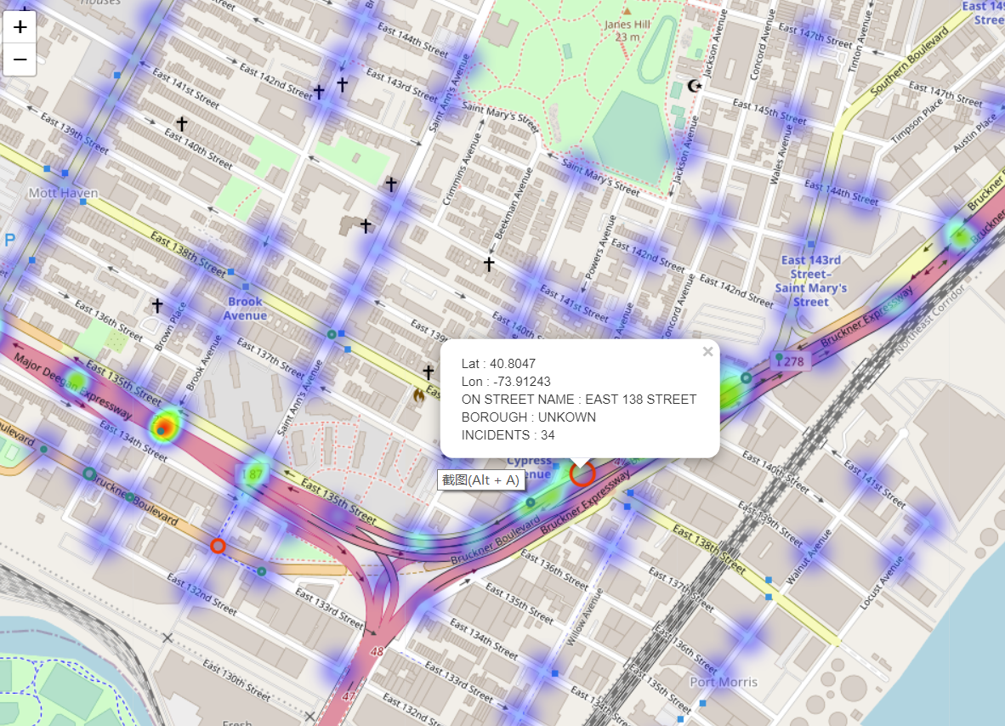
Data App Demo: Thermal Map
What kind of road is most prone to accidents?

Slide 18
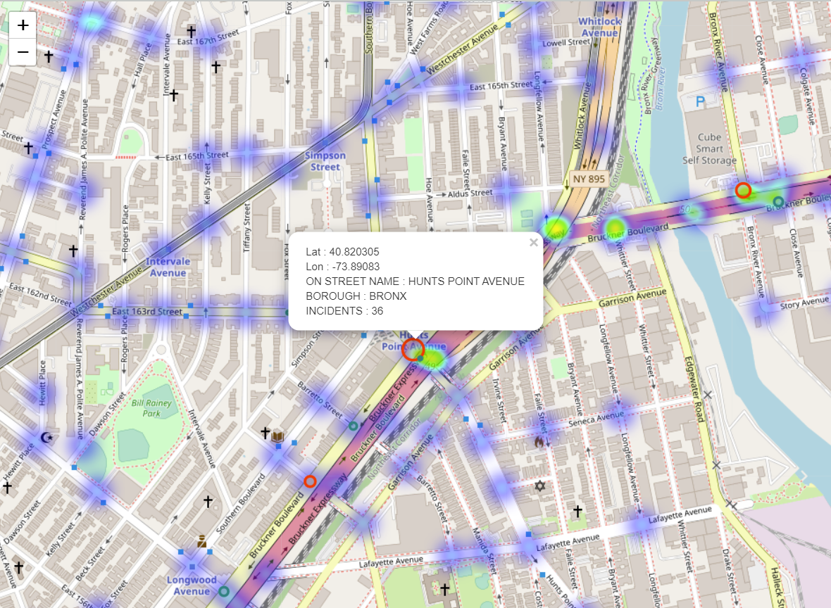
Data App Demo: Thermal Map
Conclusion:
Accidents are more likely to occur at the intersection of common roads and expressways.
This is because many of the common roads in the United States feed directly into highways

Slide 19
THANKS FOR WATCHING

